Slide 1

Medvoice biotech requirements
Gevork Asatryan

Slide 2
Introduction
Purpose: The objective of this project is to develop a mobile app that is used as a self-diagnosis tool for health issues within a social network.
Users: The app will be used by nurses, practitioners, doctors, caregivers and careclients worldwide to form a pier to pier network that expands beyond one’s local network.
Scope: To have a fully functioning sign up and login activity that will collect user information and store it in a database to be used for correlation later. Facebook login will also be integrated so we can retrieve more information from users that may be used to correlate data between similar age groups, similar interests, nearby geographic locations, etc…

Slide 3

Overall description
This app will provide smartphone users a more convenient means of assistance for identifying possible medical conditions through pulse waveform and sound waves while linking advisory support to users.

Slide 4
Interfaces
System Interfaces: Mobile apps for both iOS and Android Devices
Software Interfaces: iOS and Android devices with a TBD minimum firmware version.
Communication Interfaces: Hypertext Transfer Protocol over Secure Sockets Layer or HTTP over SSL will be used as well as Voice over Internet Protocol or VoIP for video chat conferences.
External Interfaces: HTML calls to the database to either retrieve or query information. Facebook will also become an external interface as the app will cross-communicate with it to retrieve user information.

Slide 5
Constraints
Constraints: The app/database should be able to handle multiple logins and processing of other activities simultaneously without any delays or errors. Same goes for processing payments, whether it’s done through the Google Playstore, Apple Store, or a third party online vendor account such as PayPal.
Memory Constraints: The app should be considerably small for download purposes. Facebook is an app of about 250MB with large amounts of data, so this should be well under 150MB.
Assumptions and Dependencies: Since we are using Adobe PhoneGap to turn our files into a mobile application, there are default minimum version requirements per mobile operating system. According to Adobe, all Android versions prior to 2.5.0 have been deprecated and 3.1.0 is the default version it is set to. We may also go into the apk and change those minimum version requirements, but that is out of our scope.

Slide 6
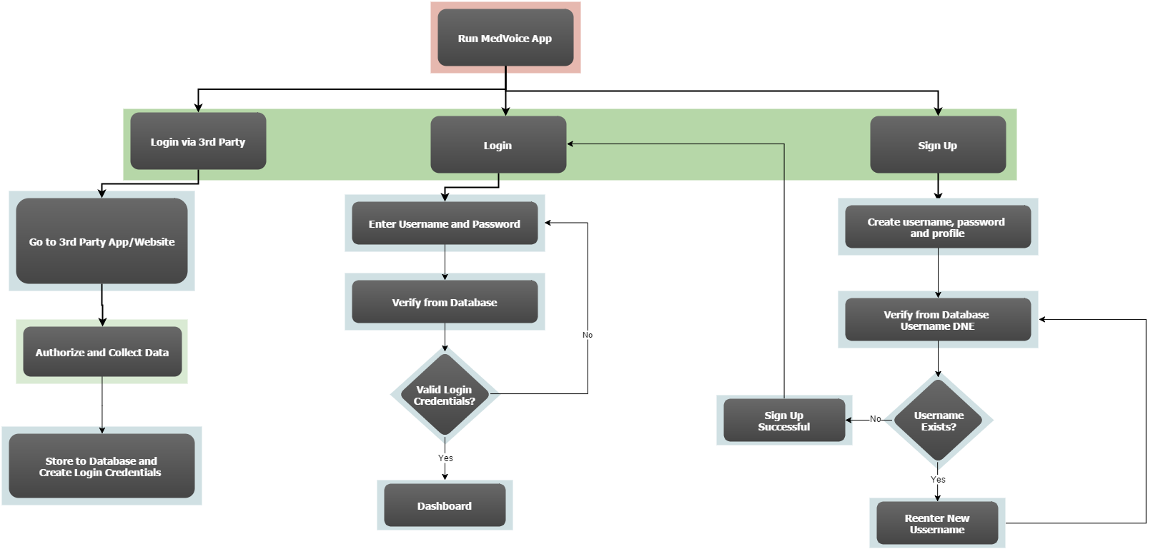
Login flowchart

Slide 7
Functions and security
Functions: Functions of the app and database would be reading/writing to the database and as well as admin access to some of that data.
Logical Database Requirements: Users will be able to push their contact information through to the database either via entering it in themselves or by a Facebook login and information retrieval.
Security: The app will host preliminary security measures, which will include a signup/login mechanism with user account’s kept private. The security features of the database will kept this information encrypted.

Slide 8
User class
User Class: Users will only be able to send data to the database, while the database will correlate said data and send said data back to the app. Users will not be able to have direct access to said data, unless they are admins then the app will provide access to certain data.

Slide 9
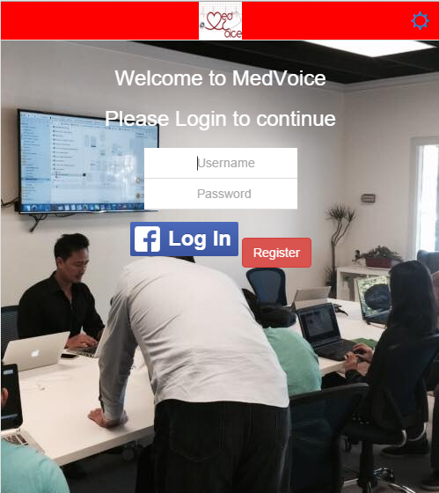
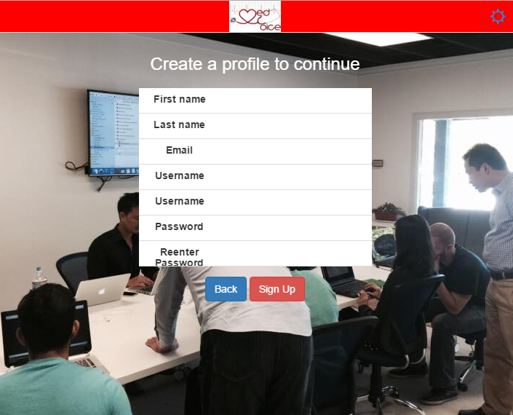
Start up screen and registration

